Slide 1



Exhaustive Analysis of Indian Agriculture using Power BI
By Dev Chaudhary

Slide 2

Learning Objectives
Power BI is a business intelligence tool by Microsoft that helps users visualize data, create interactive reports, and gain insights for decision-making. It connects to various data sources like Excel, SQL, and cloud services, allowing data transformation and modeling. With features like DAX for calculations, Power Query for data cleaning, and interactive dashboards, Power BI makes data analysis intuitive. Users can share reports via Power BI Service, enabling collaboration. Its automation, AI-driven insights, and real-time analytics make it a powerful tool for businesses and data professionals.
GOAL
Source :
www.freepik.com/

Slide 3
Tools and Technology used
Power BI Desktop – A Windows application for creating reports and dashboards.
Power BI Service – A cloud-based platform for sharing and collaborating on reports.
Power BI Mobile – A mobile app for accessing reports on the go.
Power Query – A data transformation tool for cleaning and shaping data.
Power Pivot – Used for data modeling and creating relationships.
DAX (Data Analysis Expressions) – A formula language for calculations and measures.
Power BI Gateway – Connects on-premises data sources to the cloud.
Power BI Embedded – Allows embedding reports into applications.
Power Automate – Automates workflows and data refreshes.
AI & Machine Learning – Includes AI visuals and integrations for predictive analysis.

Slide 4
Methodology
Data Collection – Connect to various data sources like Excel, SQL, APIs, and cloud services.
Data Cleaning & Transformation – Use Power Query to clean, filter, and shape data for analysis.
Data Modeling – Establish relationships between tables and use Power Pivot for data structuring.
DAX Calculations – Apply DAX formulas to create measures, calculated columns, and KPIs.
Report & Dashboard Creation – Design interactive visuals using charts, tables, slicers, and filters.
Publishing & Sharing – Upload reports to Power BI Service for collaboration and distribution.

Slide 5
Problem Statement:
India's agriculture sector is vast and complex, contributing significantly to the economy while facing numerous challenges such as unpredictable weather patterns, fluctuating crop yields, market price volatility, and regional disparities in productivity. The available agricultural data is scattered across multiple sources, including government reports, census data, and market trends, making it difficult to derive meaningful insights for policymakers, farmers, and stakeholders.
The lack of real-time, interactive analytics hampers data-driven decision-making, affecting crop planning, resource allocation, and supply chain efficiency. This project aims to develop an interactive Power BI dashboard that integrates and visualizes data on crop production, rainfall patterns, soil health, pricing trends, and government schemes. By providing dynamic insights and trend analysis, the solution will help policymakers optimize agricultural policies, assist farmers in better planning, and enable businesses to make informed investment decisions in the agricultural sector.

Slide 6
Solution:
To address the challenges in Indian agriculture, this project will develop a comprehensive Power BI dashboard that integrates and visualizes key agricultural data from multiple sources. The solution will include the following steps:
Data Collection & Integration
Gather data from government portals (e.g., Ministry of Agriculture, IMD, NABARD), market price databases, and census reports.
Connect multiple data sources (Excel, SQL databases, APIs) to Power BI for seamless integration.
Data Cleaning & Transformation
Use Power Query to clean, format, and remove inconsistencies in data.
Handle missing values and ensure standardization for uniform reporting.
Data Modeling & Relationships
Establish relationships between datasets (e.g., crop yield vs. rainfall, market prices vs. production).
Use Power Pivot to structure data efficiently for better analysis.
DAX for Advanced Calculations
Implement DAX measures to calculate key performance indicators (KPIs) such as yield per hectare, price fluctuations, and regional productivity comparisons.
Create dynamic measures for trend analysis and forecasting.

Slide 7
5.Interactive Dashboards & Visualization
Build visually engaging dashboards with charts, maps, slicers, and filters to allow users to explore data interactively.
Provide regional insights by incorporating GIS-based mapping to visualize state-wise production, rainfall distribution, and soil quality.
6.Automated Reporting & Real-time Insights
Enable scheduled data refreshes to keep insights up to date.
Use Power BI Service to publish and share reports with policymakers, farmers, and stakeholders.
7.Decision Support & Predictive Analytics
Leverage Power BI’s AI and ML integration for forecasting crop yields based on historical trends and climate data.
Provide recommendations for farmers on optimal crop selection based on soil conditions and weather forecasts.
By implementing this data-driven Power BI solution, policymakers can make informed decisions, farmers can optimize crop planning, and agribusinesses can analyze market trends efficiently, leading to a more sustainable and productive agriculture sector in India.

Slide 8
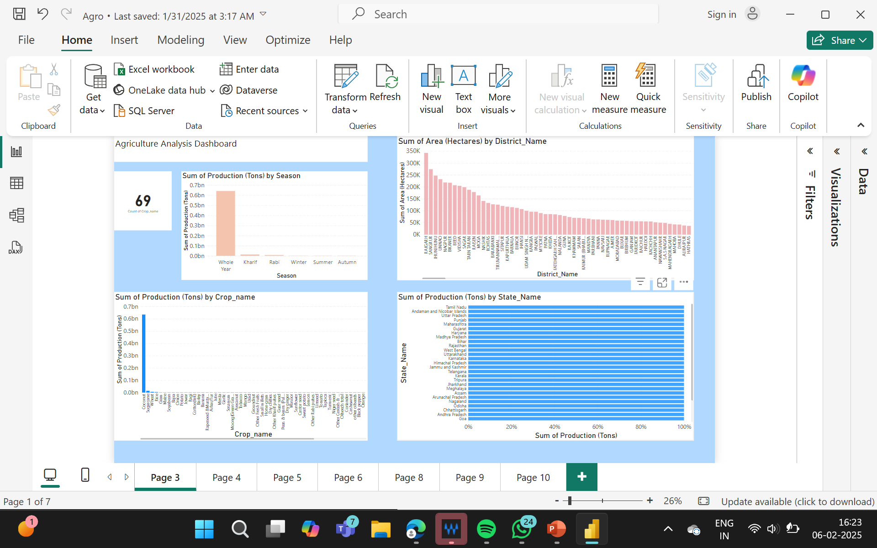
Screenshot of Output:

Slide 9
Conclusion:
The implementation of a Power BI-based agricultural analytics dashboard provides a powerful solution for addressing the challenges faced by the Indian agriculture sector. By integrating data from multiple sources, cleaning and transforming it for better usability, and leveraging advanced data modeling, this project enables real-time, data-driven decision-making.
With interactive visualizations, predictive analytics, and automated reporting, stakeholders—including policymakers, farmers, and agribusinesses—gain valuable insights into crop production trends, market prices, weather impacts, and soil health. This fosters better planning, resource optimization, and improved yield predictions, ultimately driving efficiency and sustainability in agriculture.
By transforming scattered agricultural data into meaningful insights, this solution bridges the gap between raw data and actionable intelligence, empowering decision-makers to create smarter policies, improve farmer support, and enhance food security in India.

